Slide 1
Services
OBI workshop
San Diego 2011

Slide 2
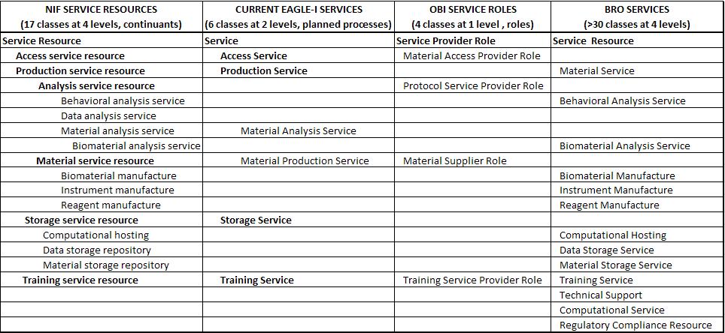
Service Modeling Landscape
Services captured in NIF, eagle-I, OBI, BRO
Typically classified first according to type of process performed (Access, Production, Analysis, Storage, etc.)
Further subclasses based on type of input/output
No logical class definitions outside of OBI
Notes:
NIF is most consistent and well developed.
BRO has more service classes but uses inconsistent classification criteria (mixes process, I/O, and subject area based principles for classification at same level of hierarchy).

Slide 3
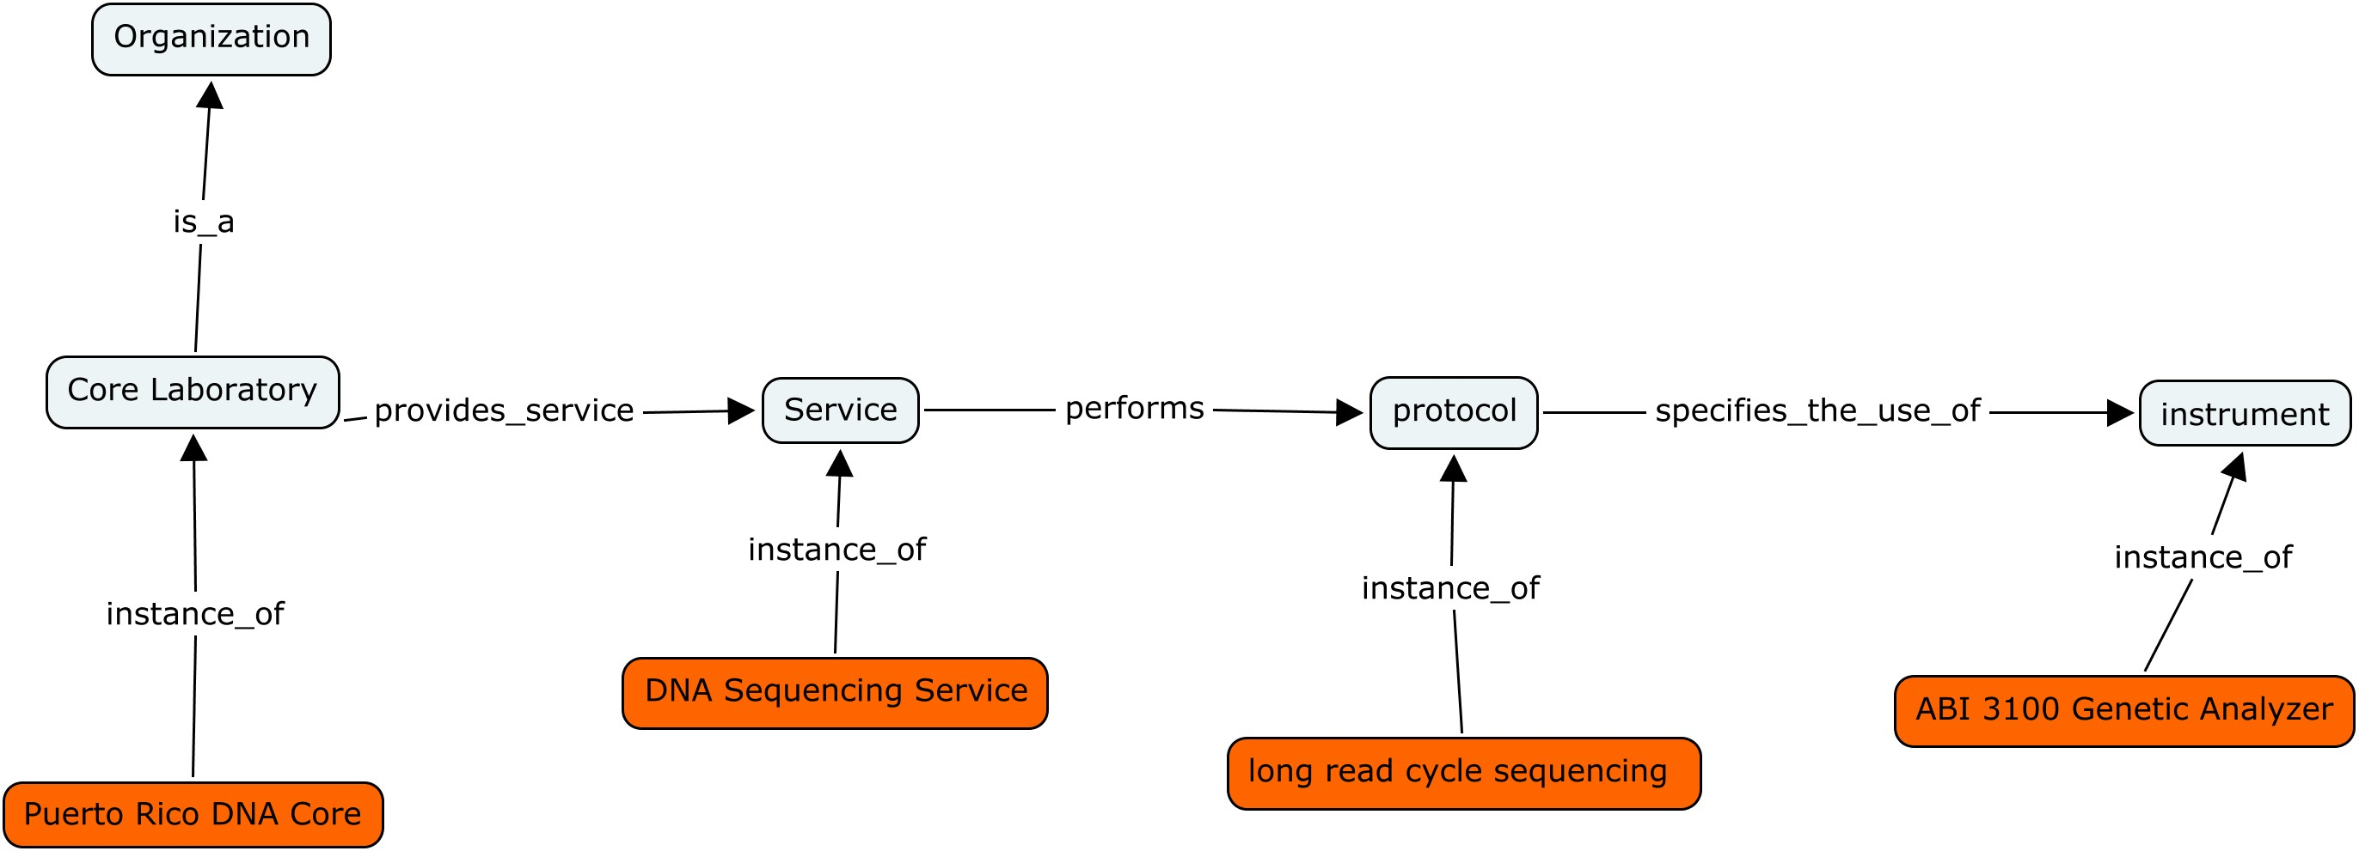
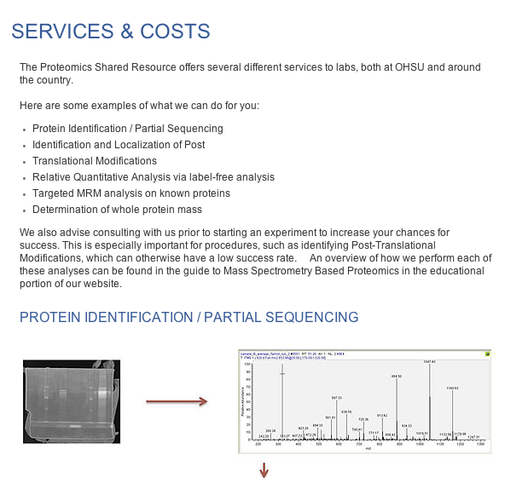
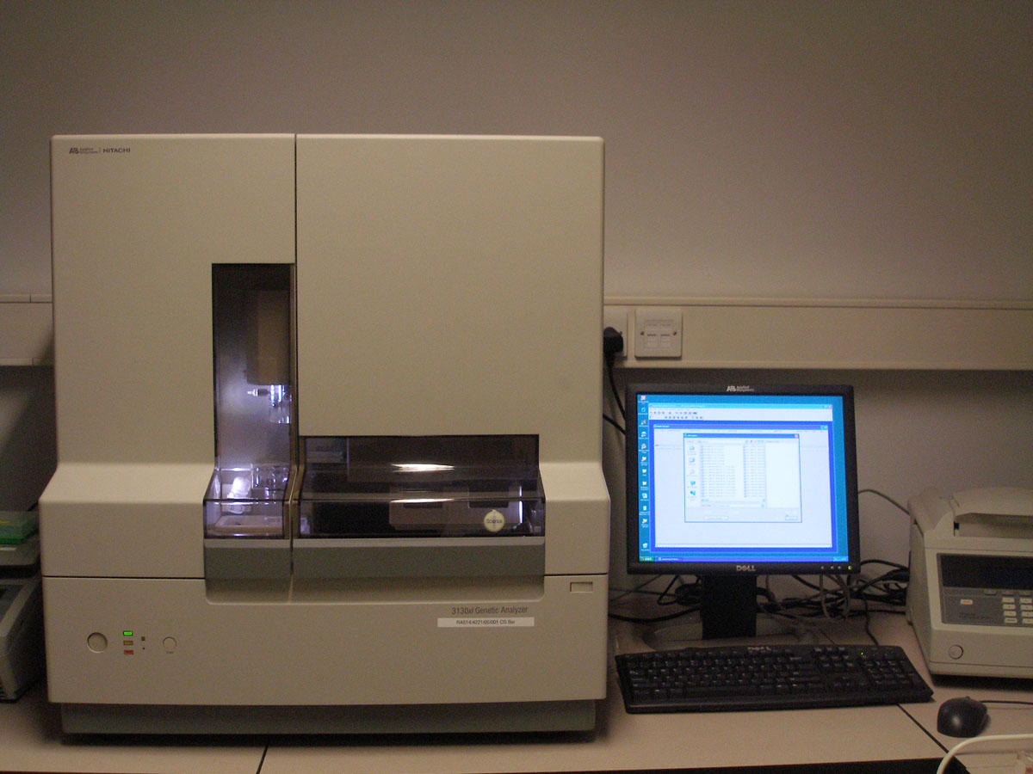
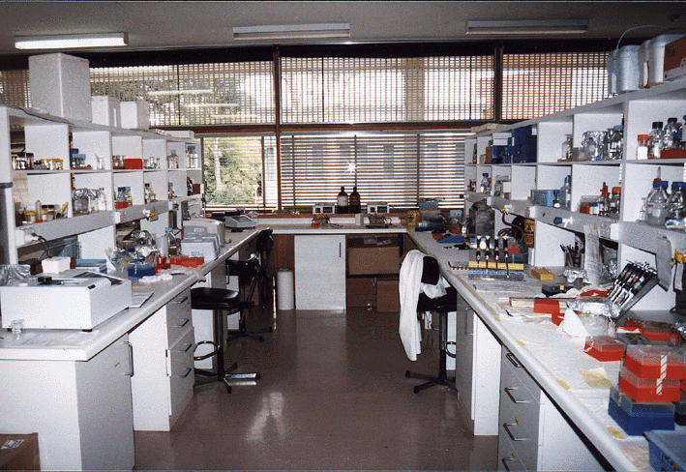
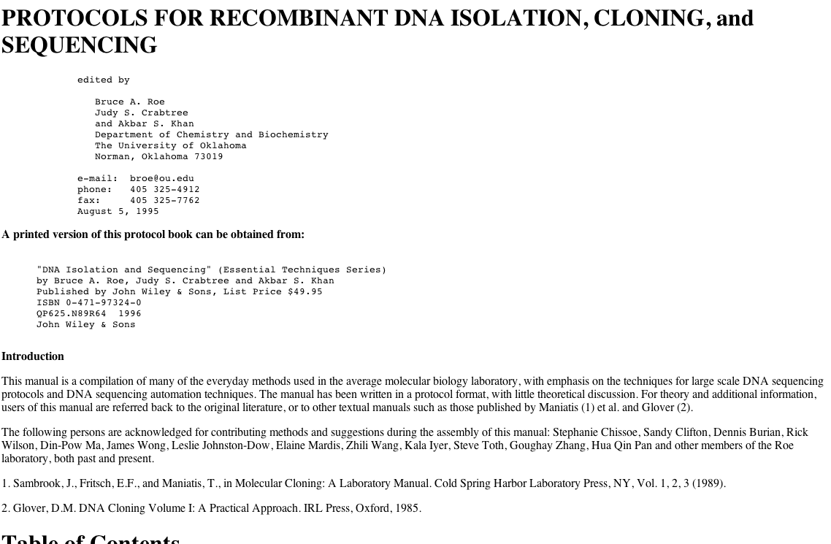


eagle-i Requirements
Classes to cover all service resources collected from participating institutions (~2500 so far)
A service hierarchy that assists service annotation and retrieval
Services logically defined to promote linking of data about resources
connect services to labs, protocols, instruments, reagents, organisms, etc.
Modeling as consistent as possible with external efforts (OBI, NIF, BRO)
c o n s o r t i u m

Slide 4
Status of Services in OBI
Services test classes modeled using
Roles (‘service provider role’, ‘service consumer role’)
Planned Processes
Objectives
Services are children of the planned processes they perform, and are defined as equivalent classes
Only two service test classes have been created in OBI so far
Example : OBI ‘DNA sequencing service’
- 'DNA sequencing' and (realizes some ('service provider role' and
('inheres in' some organization)))
Notes:
There is no ‘service’ equivalent class that subsumes services in a single inferred hierarchy

Slide 5
Design Patterns
Most Recent Proposal
Models services as planned processes with participating persons/organizations (service provider, customer), and specified input/output (material, data)
‘material analysis service’ as ‘assay’ which incorporates a service provider performing an assay on an input material given by the customer and returning information to the customer
Notes:
Most recent proposal

Slide 6
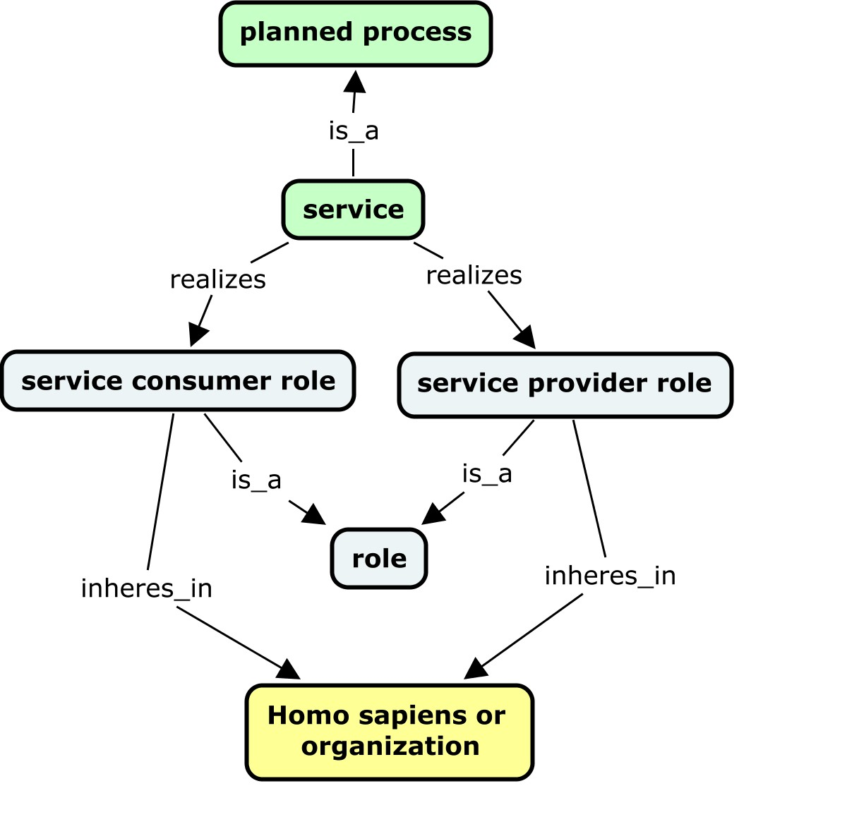
Design Patterns
eagle-i proposal
Services implemented as equivalent classes under their
parent planned process (as currently done in OBI)
A ‘service’ hierarchy containing all service classes can be inferred
Design Pattern:
A service is defined as a ‘planned process’ that
(1) realizes some ‘service provider role’ and inheres_in some (‘homo sapiens’ or ‘organization’)
(2) realizes some ‘service consumer role’ and inheres_in some (‘homo sapiens’ or ‘organization’)
Notes:
eagle-i proposal captures these same entities and is consistent with how services currently modeled in OBI
Note that if we use our proposed design pattern, we would have the same basic high level hierarchy for modeling planned processes and services (as the service hierarchy will be generated from the planned process hierarchy)
- So, we are perhaps doing this backwards by modeling/classifying services first, before planned processes?
- Is the hierarchy we created above for services sufficient for planned processes?

Slide 7
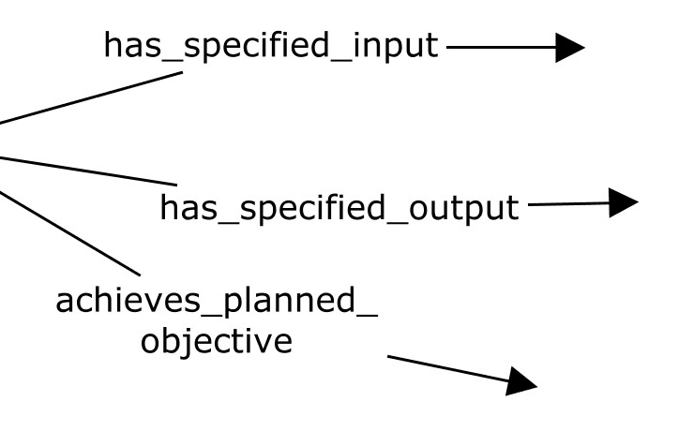
Design Patterns
eagle-I proposal
Services implemented as equivalent classes under their
parent planned process (as currently done in OBI)
A ‘service’ hierarchy containing all services can be inferred
, etc
Inherited Axioms
Design Pattern:
A service is defined as a ‘planned process’ that
(1) realizes some ‘service provider role’ and inheres_in some (‘homo sapiens’ or ‘organization’)
(2) realizes some ‘service consumer role’ and inheres_in some (‘homo sapiens’ or ‘organization’)
Services will inherit axioms from their parent planned process that describe participants (input, output), objectives, aboutness, etc
Notes:
- Note that if we use our proposed design pattern, we would have the same basic high level hierarchy for modeling planned processes and services (as the service hierarchy will be generated from the planned process hierarchy)
- So, we are perhaps doing this backwards by modeling/classifying services first, before planned processes?
- Is the hierarchy we created above for services sufficient for planned processes?

Slide 8
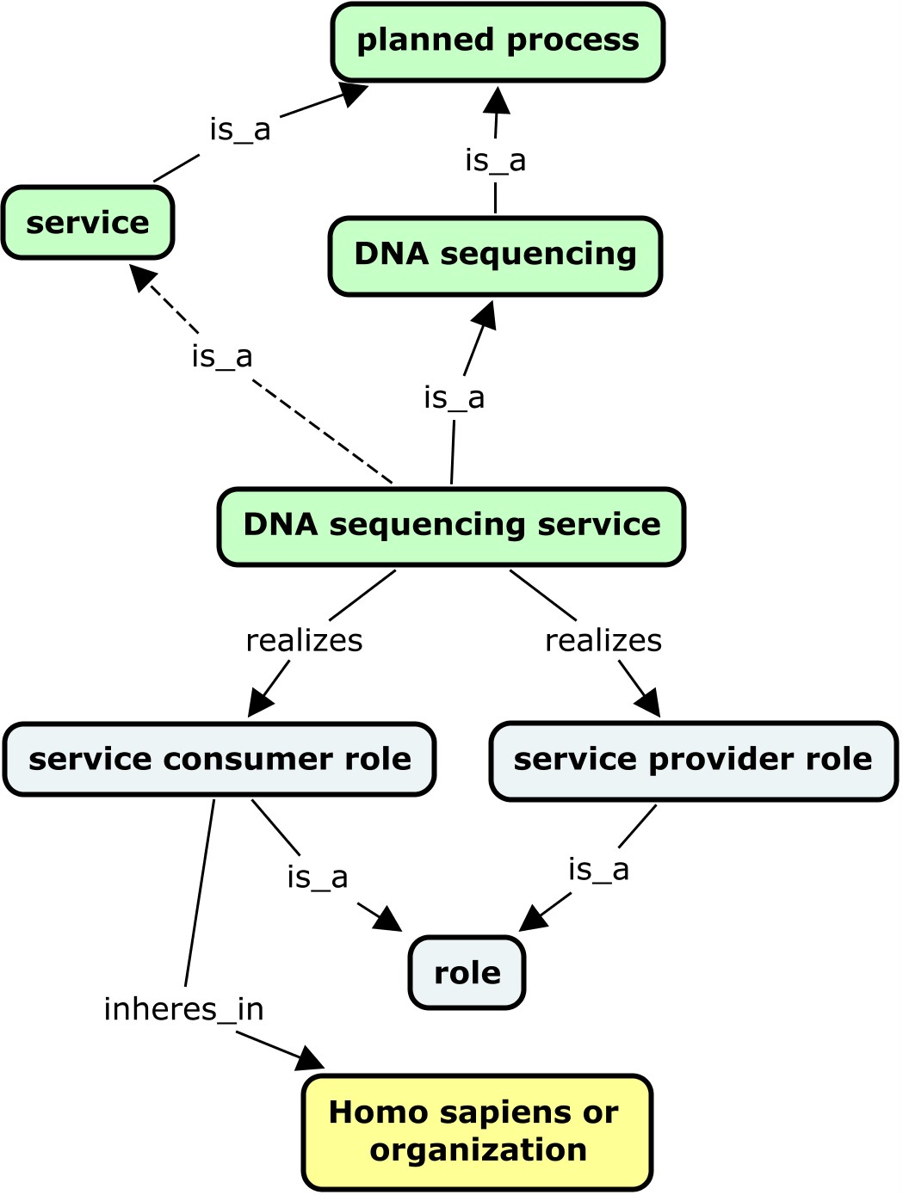
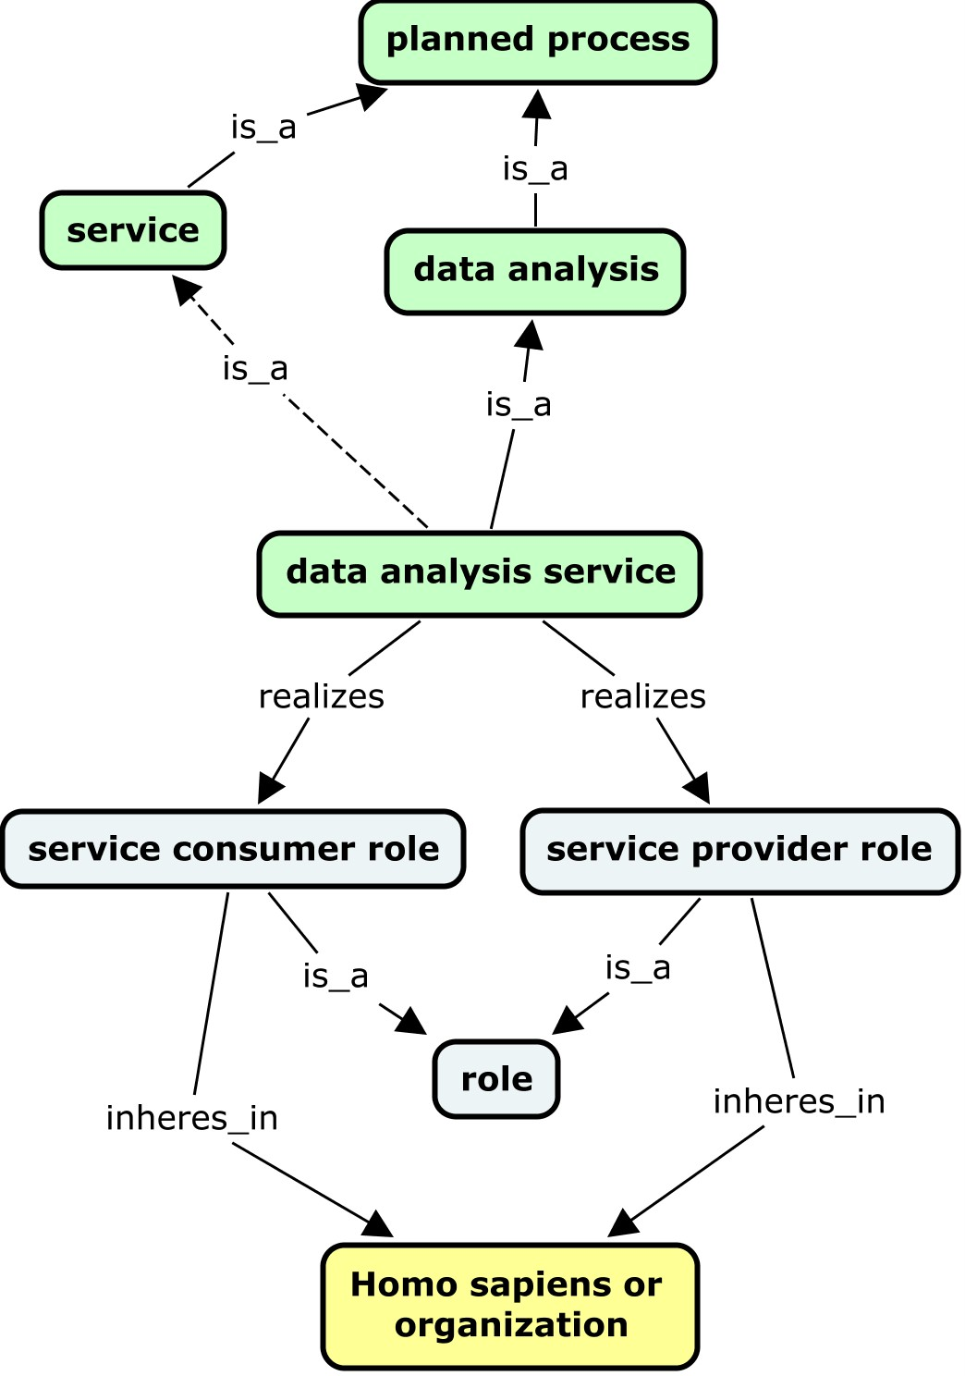
Example : eagle-i ‘DNA sequencing service’
Class Definition: 'DNA sequencing' and (realizes some ('service provider role' and ('inheres in' some (organization or 'Homo sapiens')))) and (realizes some ('service consumer role' and ('inheres in' some (organization or 'Homo sapiens'))))

Slide 9
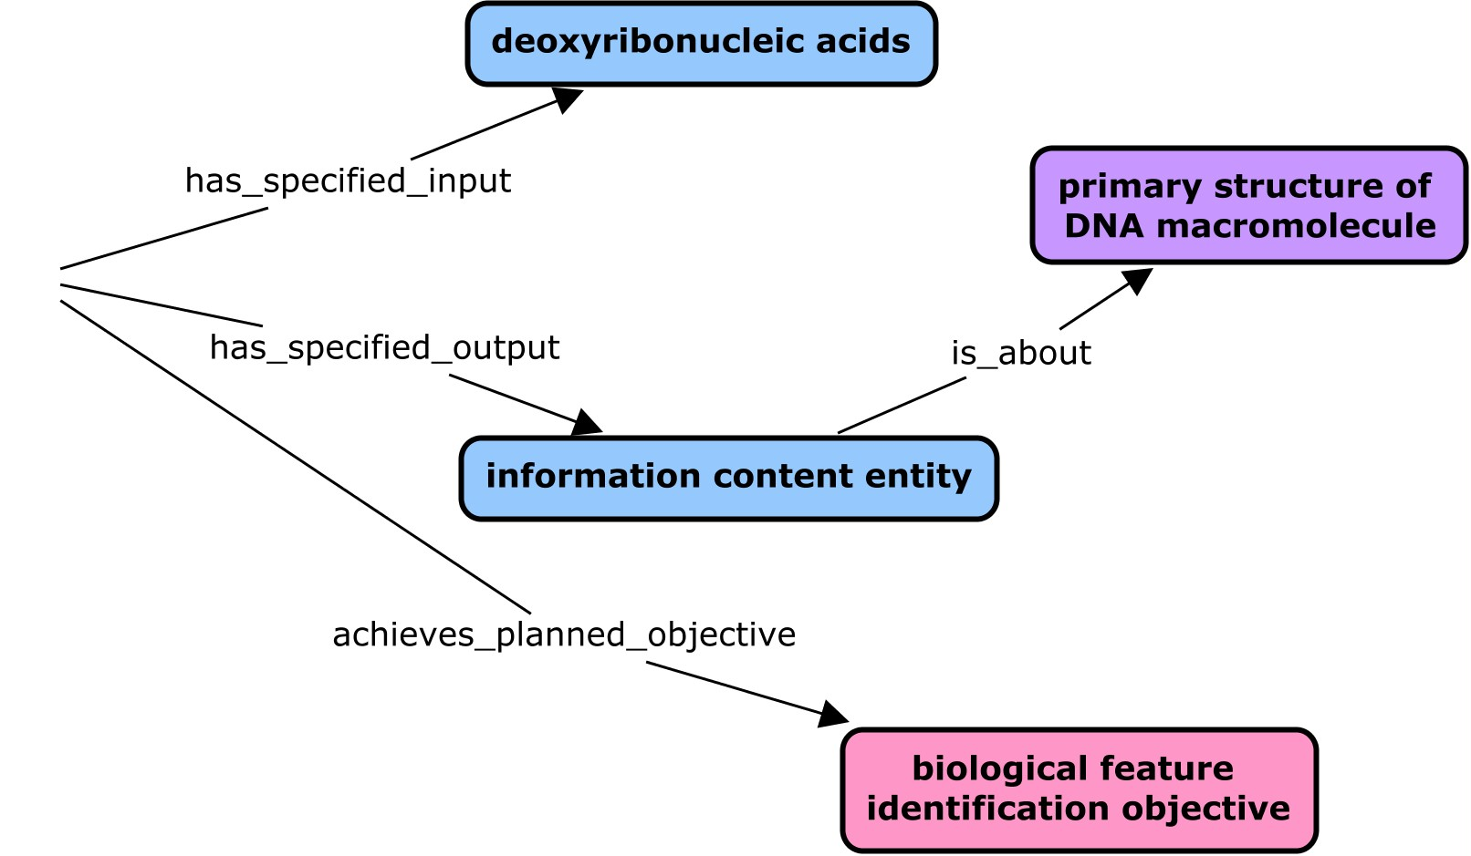
Example : ‘DNA sequencing service’
Class Definition: 'DNA sequencing' and (realizes some ('service provider role' and ('inheres in' some (organization or 'Homo sapiens')))) and (realizes some ('service consumer role' and ('inheres in' some (organization or 'Homo sapiens'))))
Inherited Axioms

Slide 10
Example : ‘data analysis service’
Class Definition: ‘data analysis' and (realizes some ('service provider role' and ('inheres in' some (organization or 'Homo sapiens')))) and (realizes some ('service consumer role' and ('inheres in' some (organization or 'Homo sapiens'))))

Slide 11
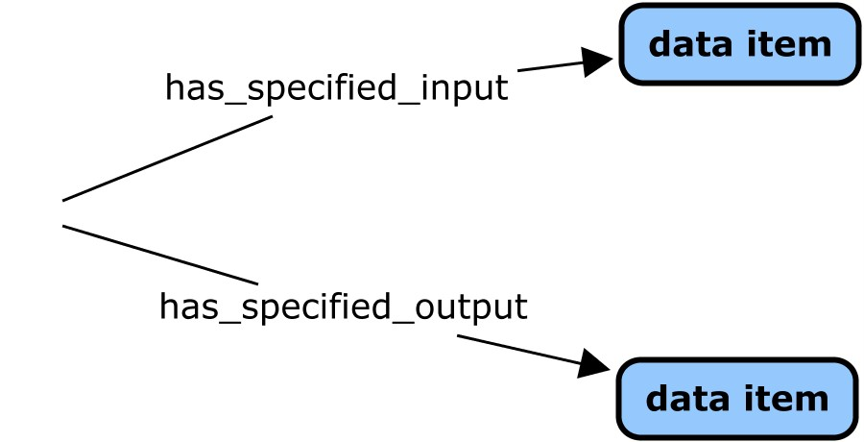
Example : eagle-i ‘data analysis service’
Class Definition: ‘data analysis' and (realizes some ('service provider role' and ('inheres in' some (organization or 'Homo sapiens')))) and (realizes some ('service consumer role' and ('inheres in' some (organization or 'Homo sapiens'))))
Inherited Axioms

Slide 12
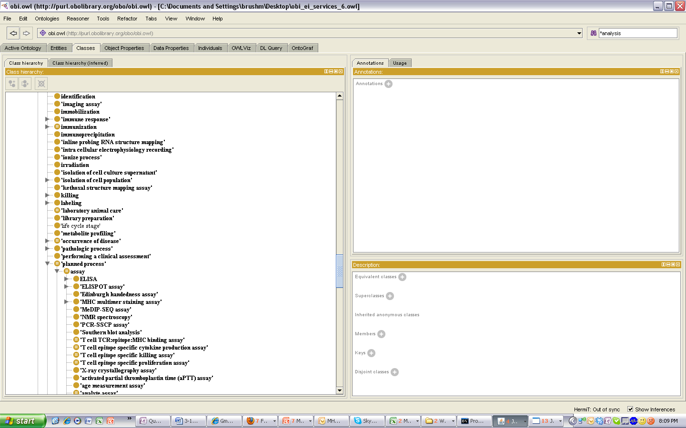
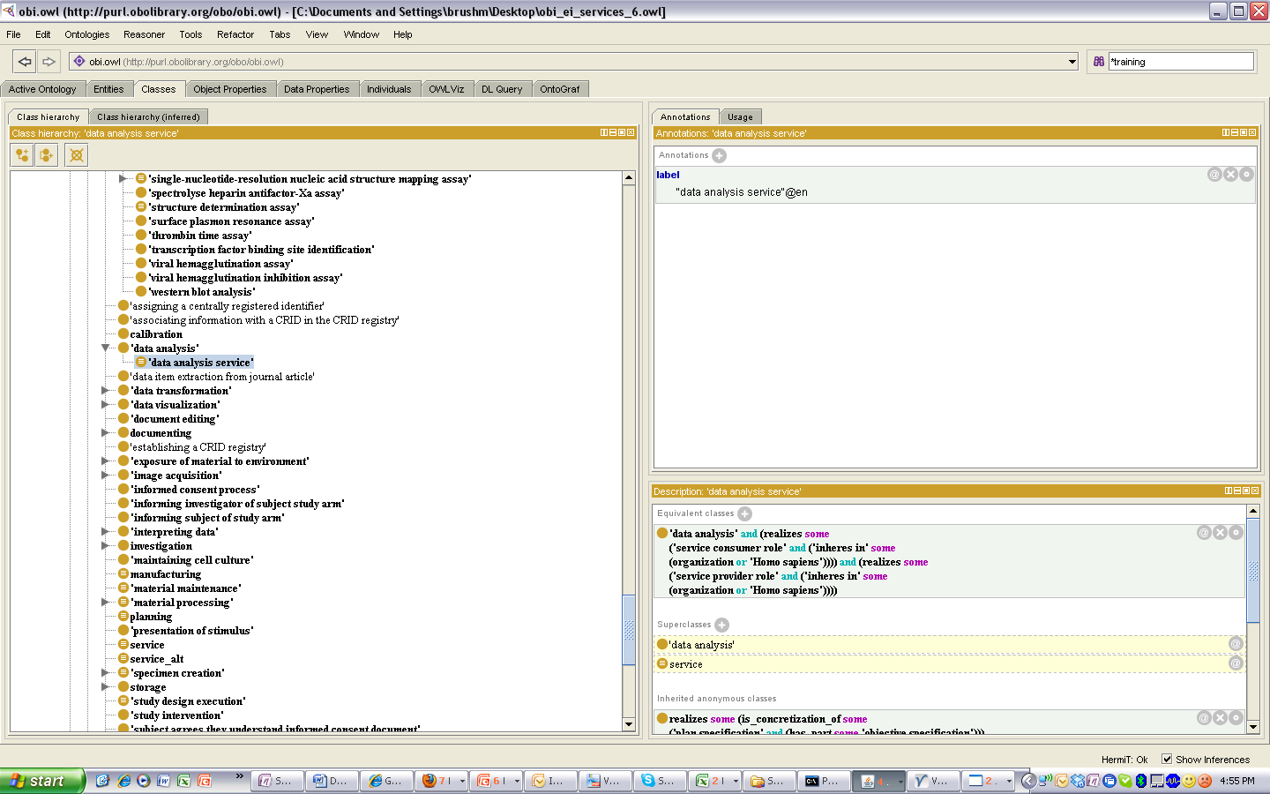
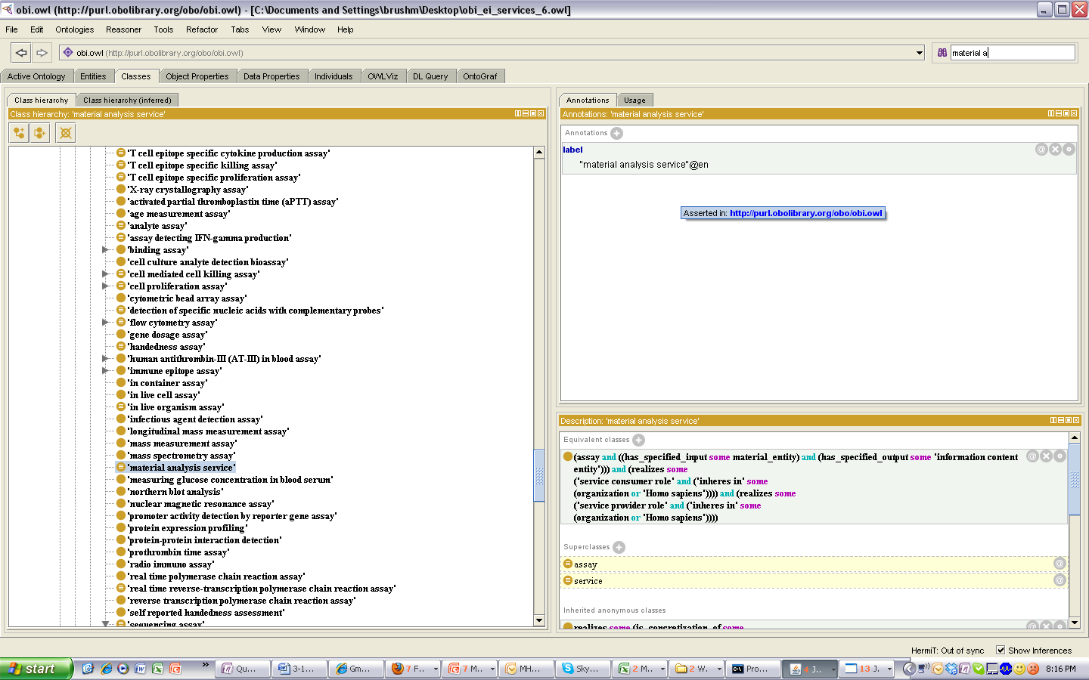
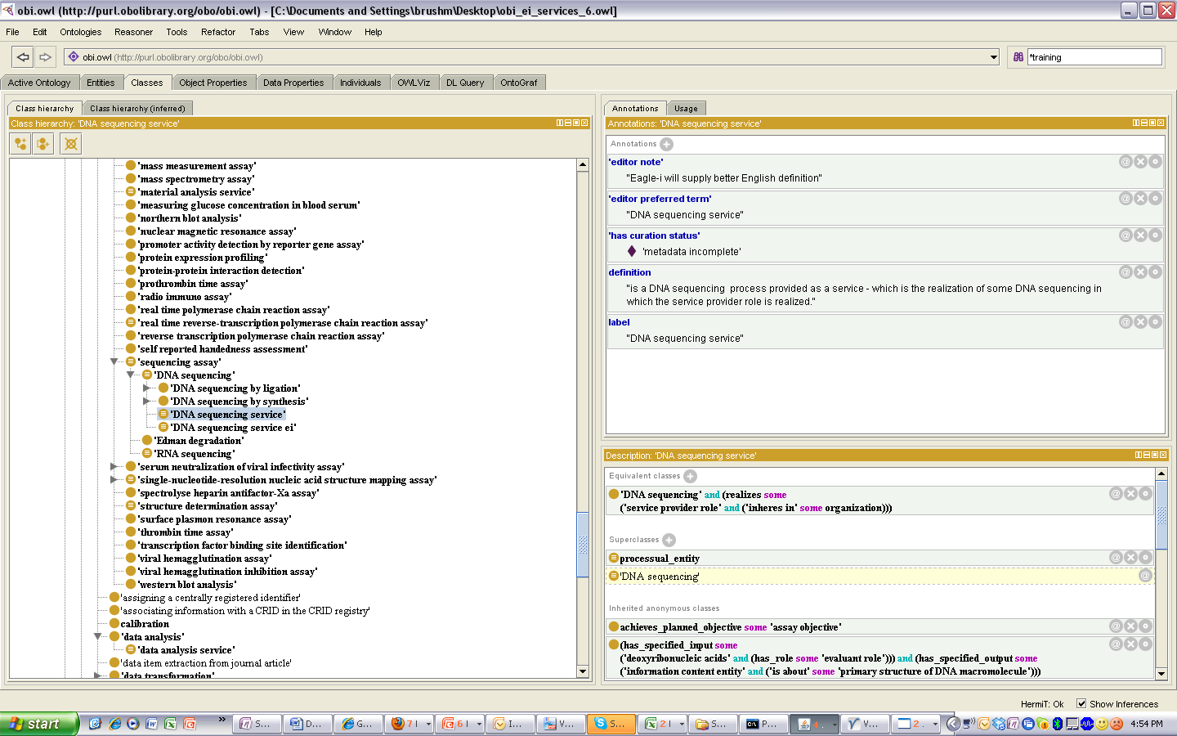
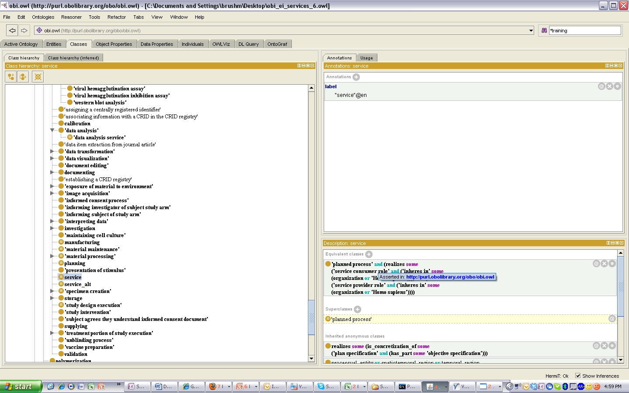
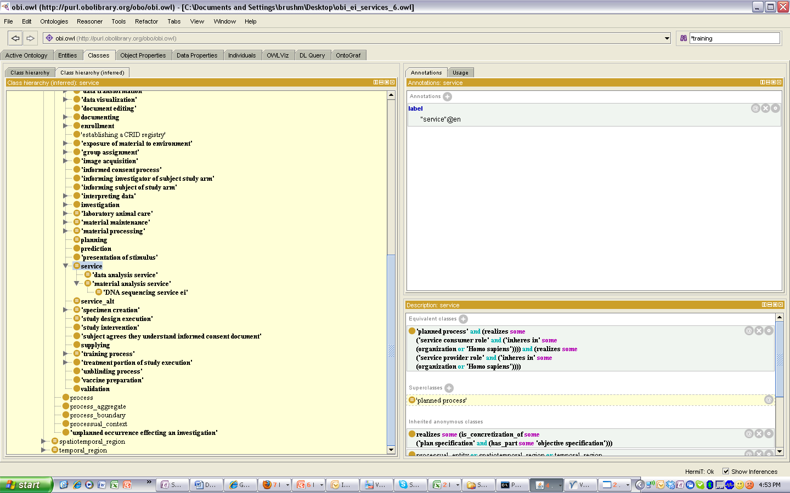
Planned Process and Service Hierarchies
Asserted planned process hierarchy
Consequence of Design Pattern: Planned process hierarchy will “match” service hierarchy
*
Inferred planned process>service hierarchy
*assay = material analysis

Slide 13
Service Classification
Service hierarchy with process-based classification for its top level distinctions (consistent with NIF, BRO)
Secondary classification based on input/output of process
‘Processing Service’ subsumes Production and Modification (and possibly Maintenance, depending on how ‘processing’ is defined)
Service
Access Service
Material Access Service
IT Access Service
Data Access Service
Analysis Service
Material Analysis Service
Data Analysis Service
Processing Service
Material Processing Service
Material Production Service
Material Modification Service
Data Processing Service
Data Visualization
Data Cleaning
Data Normalization
Maintenance Service
Material Maintenance Service
Data Maintenance Service
Storage Service
Material Storage Service
Data Storage Service
Training Service
Support Service
Material Transport Service
c o n s o r t i u m
Notes:
Questions :
What is processing, in relation to Production, Modification, Maintenance
Is ‘processing’ too vague to be useful as a top level class?
What is considered Data Analysis (can data modifications such as data visualization and data cleaning, which do not generate ’NEW’ data, be subsumed by ‘data analysis’?

Slide 14
Service Classification
Alternate service hierarchy with process-based classification for its top level distinctions (consistent with NIF, BRO)
Secondary classification based on input/output of process
‘Processing Service’ removed (too vague?), ‘Data Processing’ classes subsumed by ‘Analysis Service’, and Material Production, Material Modification Services become top level classes
Service
Access Service
Material Access Service
IT Access Service
Data Access Service
Analysis Service
Material Analysis Service
Data Analysis Service (Data Processing Service)
Statistical Analysis Service
Data Visualization
Data Cleaning
Material Production Service
Material Modification Service
Maintenance Service
Material Maintenance Service
Data Maintenance Service
Database Management
Storage Service
Material Storage Service
Data Storage Service
Training Service
Support Service
Material Transport Service
c o n s o r t i u m
Notes:
Questions :
What is processing, in relation to Production, Modification, Maintenance
Is ‘processing’ too vague to be useful as a top level class?
What is considered Data Analysis (can data modifications such as data visualization and data cleaning, which do not generate ’NEW’ data, be subsumed by ‘data analysis’?

Slide 15
Service Classification
Service hierarchy with input/output-based top level distinction
material vs data distinction made first, and secondary classification based on process performed
Service
Materials Service
Material Access Service
Material Analysis Service
Material Processing Service
Material Production Service
Material Modification Service
Material Maintenance Service
Material Storage Service
Data Service (IT Service?)
Data Analysis Service
Data Processing Service
Data Visualization
Data Cleaning
Data Maintenance Service
Database Management
Data Storage Service
IT /Data Access Service
Software Access Service?
Training Service
Support Service
Material Transport Service
c o n s o r t i u m
Notes:
May be more intuitive for researchers without ontology/curation experience to select a Material Vs Data service first? (good for eagle-I where those annotating data will not be curators/onotolgists.
*** analysis gives data ABOUT input. This is what sets it apart from processing, which processes some input into a transformed version of the input as output . . . but there is no aboutness. So Data transformation is indeed a processing, because it returns data from data, but that data is not ABOUT the input data, it IS the input data in a different form (just like the output of material processing IS the input just in a different form). However, ONLY PROBLEM is that “Processing Service” seems vague and unclear/unintuitive
Processing subsumes production and modification

Slide 16
Application(Domain)-Based Service Classification
For driving the eagle-I search UI, application-based classes may be more intuitive than process- and input/output-based classification
Therefore, equivalent classes for application-based service categories will be created to aid in resource discovery
Flow Cytometry Service
Molecular Biology Service
Cell Culture Service
Protein Chemistry Service
Proteomics Service
Histology and Pathology Services
Stem Cell Service
Transgenics Service
Notes:
Note that these classes can subsume classes from multiple process-based categories
For ex , ‘Flow Cytometry Services’ can include Material Processing services, Material Analysis service, Training services, Support Services, etc.
These equivalent classes will align when possible with domain-based categories used by core service databases such as ABRF, VGN, Harvard Catalyst Cores
Note that such domain/application-based classes are already needed to annotate instances of service offerings of a more general/vague nature already captured in eagle-i, such as ‘Flow Cytometry Services’, (Harvard) ‘Molecular Biology Services’ (Puerto Rico)
Note that classification of flow cytometry service as detailed above will require (technique-based) device hierarchy classification . . . ie grouping all flow cytometry-associated devices together in the device branch of OBI
An alternative (and more aligned with OBI) approach for ‘flow cytometry service’ is : ‘service’ and realizes some (‘function’ and inheres_in some ‘flow cytometry device’)
Question : if a process realizes a function/role that inheres in some material entity, can it be inferred that the material entity participates_in the process? If so, is a reasoner configured to infer this and classify an ontology accordingly?
For ex, if flow cytometry service were defined using the participates in relation, and there were some service process that realizes a function inhering in some flow cytometry device, would the reasoner classify this service as a flow cytometry service?
Question : Will equivalent classes allow for (1) class-based inferencing such that appropriately defined asserted classes are subsumed by our domain/application based equivalent classes asserted classes (for ex, a cell sorting service that is defined to have_participant some flow cytometer), as well as (2) instance based classification (which can occur only if appropriate attributes of instances are recorded – for ex instruments associated with the service)

Slide 17
Application-Based Equivalent Classes
Application-based equivalent classes can be defined using axioms placed on asserted service classes that specify
service participants (agents, input/output)
realization of functions/roles
aboutness of information content entity input or output
Example: ‘flow cytometry service’
- ‘service’ and (has_participant some ‘flow cytometry device’)
will subsume any service that has_participant’ some ‘flow cytometry device, including:
- material processing services such as ‘FACS cell sorting service’
- material analysis services such as ‘cell-binding detection service’
- training services that instruct on the use of flow cytometers
Example: ‘molecular biology service’
- ‘service’ and (has_specified_output some (‘biological macromolecule’ or
(‘measurement datum’ and (is_about some ‘biological macromolecule’)))
Notes:
Example : ‘crystallography service’ – ‘service’ and realizes some (‘objective specification’ and about some crystallography subject area )
Note that classification of flow cytometry service as detailed above will require (technique-based) device hierarchy classification . . . ie grouping all flow cytometry-associated devices together in the device branch of OBI
An alternative (and more aligned with OBI) approach for ‘flow cytometry service’ is : ‘service’ and realizes some (‘function’ and inheres_in some ‘flow cytometry device’)
Question : if a process realizes a function/role that inheres in some material entity, can it be inferred that the material entity participates_in the process? If so, is a reasoner configured to infer this and classify an ontology accordingly?
For ex, if flow cytometry service were defined using the participates in relation, and there were some service process that realizes a function inhering in some flow cytometry device, would the reasoner classify this service as a flow cytometry service?
Question : Will equivalent classes allow for (1) class-based inferencing such that appropriately defined asserted classes are subsumed by our domain/application based equivalent classes asserted classes (for ex, a cell sorting service that is defined to have_participant some flow cytometer), as well as (2) instance based classification (which can occur only if appropriate attributes of instances are recorded – for ex instruments associated with the service)

Slide 18
Proposed Hierarchy
Service
Access Service (def: access provided to a resource -material entity or data - for a limited time)
Materials Service (def: material is input OR output of the service)
Material Analysis Service (DNA sequencing, cell cycle analysis)
Material Processing Service
Material Production Service (cell line creation)
Material Modification Service (cell line immortalization)
Material Maintenance Service (model organism colony maintenance)
Material Storage Service (liquid nitrogen storage service)
Material Transport Service (chemical disposal service)
Data Service (def: data is input AND output of the service)
Data Analysis/Transformation Service (statistical analysis service)
Data Maintenance Service (database management)
Data Storage Service (data backup service)
Training Service
Support Service
Notes:
Note that these classes can subsume classes from multiple process-based categories
For ex , ‘Flow Cytometry Services’ can include Material Processing services, Material Analysis service, Training services, Support Services, etc.
These equivalent classes will align when possible with domain-based categories used by core service databases such as ABRF, VGN, Harvard Catalyst Cores
Note that such domain/application-based classes are already needed to annotate instances of service offerings of a more general/vague nature already captured in eagle-i, such as ‘Flow Cytometry Services’, (Harvard) ‘Molecular Biology Services’ (Puerto Rico)
Note that classification of flow cytometry service as detailed above will require (technique-based) device hierarchy classification . . . ie grouping all flow cytometry-associated devices together in the device branch of OBI
An alternative (and more aligned with OBI) approach for ‘flow cytometry service’ is : ‘service’ and realizes some (‘function’ and inheres_in some ‘flow cytometry device’)
Question : if a process realizes a function/role that inheres in some material entity, can it be inferred that the material entity participates_in the process? If so, is a reasoner configured to infer this and classify an ontology accordingly?
For ex, if flow cytometry service were defined using the participates in relation, and there were some service process that realizes a function inhering in some flow cytometry device, would the reasoner classify this service as a flow cytometry service?
Question : Will equivalent classes allow for (1) class-based inferencing such that appropriately defined asserted classes are subsumed by our domain/application based equivalent classes asserted classes (for ex, a cell sorting service that is defined to have_participant some flow cytometer), as well as (2) instance based classification (which can occur only if appropriate attributes of instances are recorded – for ex instruments associated with the service)

